Slide 1
TNSDC-Generative AI
Eye Cancer detection using CNN
Presented by :Prabakar K,
au211521104108,
Pre-Final Student,
Computer Science and Engineering,
Panimalar Institute of Technology.

Slide 2

OUTLINE
Problem Statement
Proposed Solution
System Approach
Algorithm
Result
Conclusion
References

Slide 3
PROBLEM STATEMENT
Eye cancer, or ocular malignancy, is a rare but potentially devastating condition that requires prompt diagnosis and treatment to improve patient outcomes. Traditional methods of detecting eye cancer often rely on manual examination by ophthalmologists, which can be time-consuming, subjective, and prone to human error. Additionally, access to specialized healthcare facilities for accurate diagnosis may be limited in certain regions, leading to delayed detection and treatment initiation.

Slide 4
PROPOSED SOLUTION
Deep Learning-Based Automated Eye Cancer Detection System
Our proposed solution leverages state-of-the-art deep learning techniques to develop an automated system for the detection of eye cancer. The system integrates advanced image processing algorithms, convolutional neural networks (CNNs), and comprehensive datasets to achieve accurate and efficient diagnosis. Below are the key components of our proposed solution:
We will collaborate with medical institutions and research organizations to collect a diverse and annotated dataset of eye images encompassing various types and stages of eye cancer, including retinoblastoma, melanoma, and lymphoma.
Data preprocessing techniques, such as normalization, augmentation, and noise reduction, will be applied to enhance the quality and diversity of the dataset, ensuring robust model training.
We will employ CNN architectures, such as ResNet, DenseNet, or EfficientNet, for feature extraction from input eye images. These architectures have demonstrated superior performance in image classification tasks and are well-suited for medical imaging analysis

Slide 5
SYSTEM APPROACH
Hardware:
CPU: The system requires a CPU with sufficient processing power to handle the computational demands of Convolutional Neural Network (CNN) training and inference. A multi-core processor, preferably with a clock speed of at least 2 GHz or higher, is recommended.
Memory: A minimum of 8 GB RAM is recommended for smooth operation, especially during model training, where large datasets are processed. More RAM may be required for handling larger datasets or concurrent user requests.
Internet Speed: A stable internet connection is necessary for downloading and updating Python packages, model weights, and serving the web application. A broadband connection with a minimum download speed of 5 Mbps and upload speed of 1 Mbps is sufficient for most purposes.

Slide 6
SYSTEM APPROACH – CONT.
Software:
Python: The system is built using Python programming language
PyTorch: PyTorch, a machine learning library, is utilized for implementing the Convolutional Neural Network (CNN) architecture. PyTorch provides efficient tensor computation with GPU acceleration, facilitating faster model training and inference.
Python-facepp – To install this module type the below command in the terminal. Pip install python-facepp emoji – To install this module type the below command in the terminal. Pip install emoji.
This app compares two photographs of the same person or two different persons against his/her face features like face landmarks, beauty score, face emotion, etc. If both photographs are matching with each other, the app result is “Both photographs are of same person ” otherwise app result is “Both photographs are of two different persons”.

Slide 7

ALGORITHM
Below is a simplified algorithm outline for eye cancer detection using deep learning techniques. This algorithm assumes the availability of a labeled dataset containing images of eyes with and without cancerous conditions.
Algorithm for Eye Cancer Detection:
Data Preparation:
Collect a dataset of eye images, including both healthy and cancerous conditions. Ensure that the dataset is diverse and representative of various eye cancer types and stages.
Preprocess the images by resizing them to a uniform size, normalizing pixel values, and augmenting the dataset to increase its diversity and robustness.
Model Selection:
Choose an appropriate deep learning architecture for image classification tasks. Common choices include Convolutional Neural Networks (CNNs) such as ResNet, Inception, or VGG.

Slide 8
ALGORITHM - CONT.
3.Model Training:
Split the dataset into training, validation, and testing sets. Typically, the data is divided into 70-80% for
training, 10-15% for validation, and 10-15% for testing.
Initialize the selected CNN architecture and train it on the training dataset. During training, adjust the model's parameters (weights and biases) using an optimization algorithm (e.g., stochastic gradient descent) to minimize the loss function.
4.Model Evaluation:
Evaluate the trained model's performance on the testing set to assess its accuracy, sensitivity, specificity, and other relevant metrics.
Utilize receiver operating characteristic (ROC) curves and area under the curve (AUC) to evaluate the model's ability to discriminate between healthy and cancerous eye images.

Slide 9
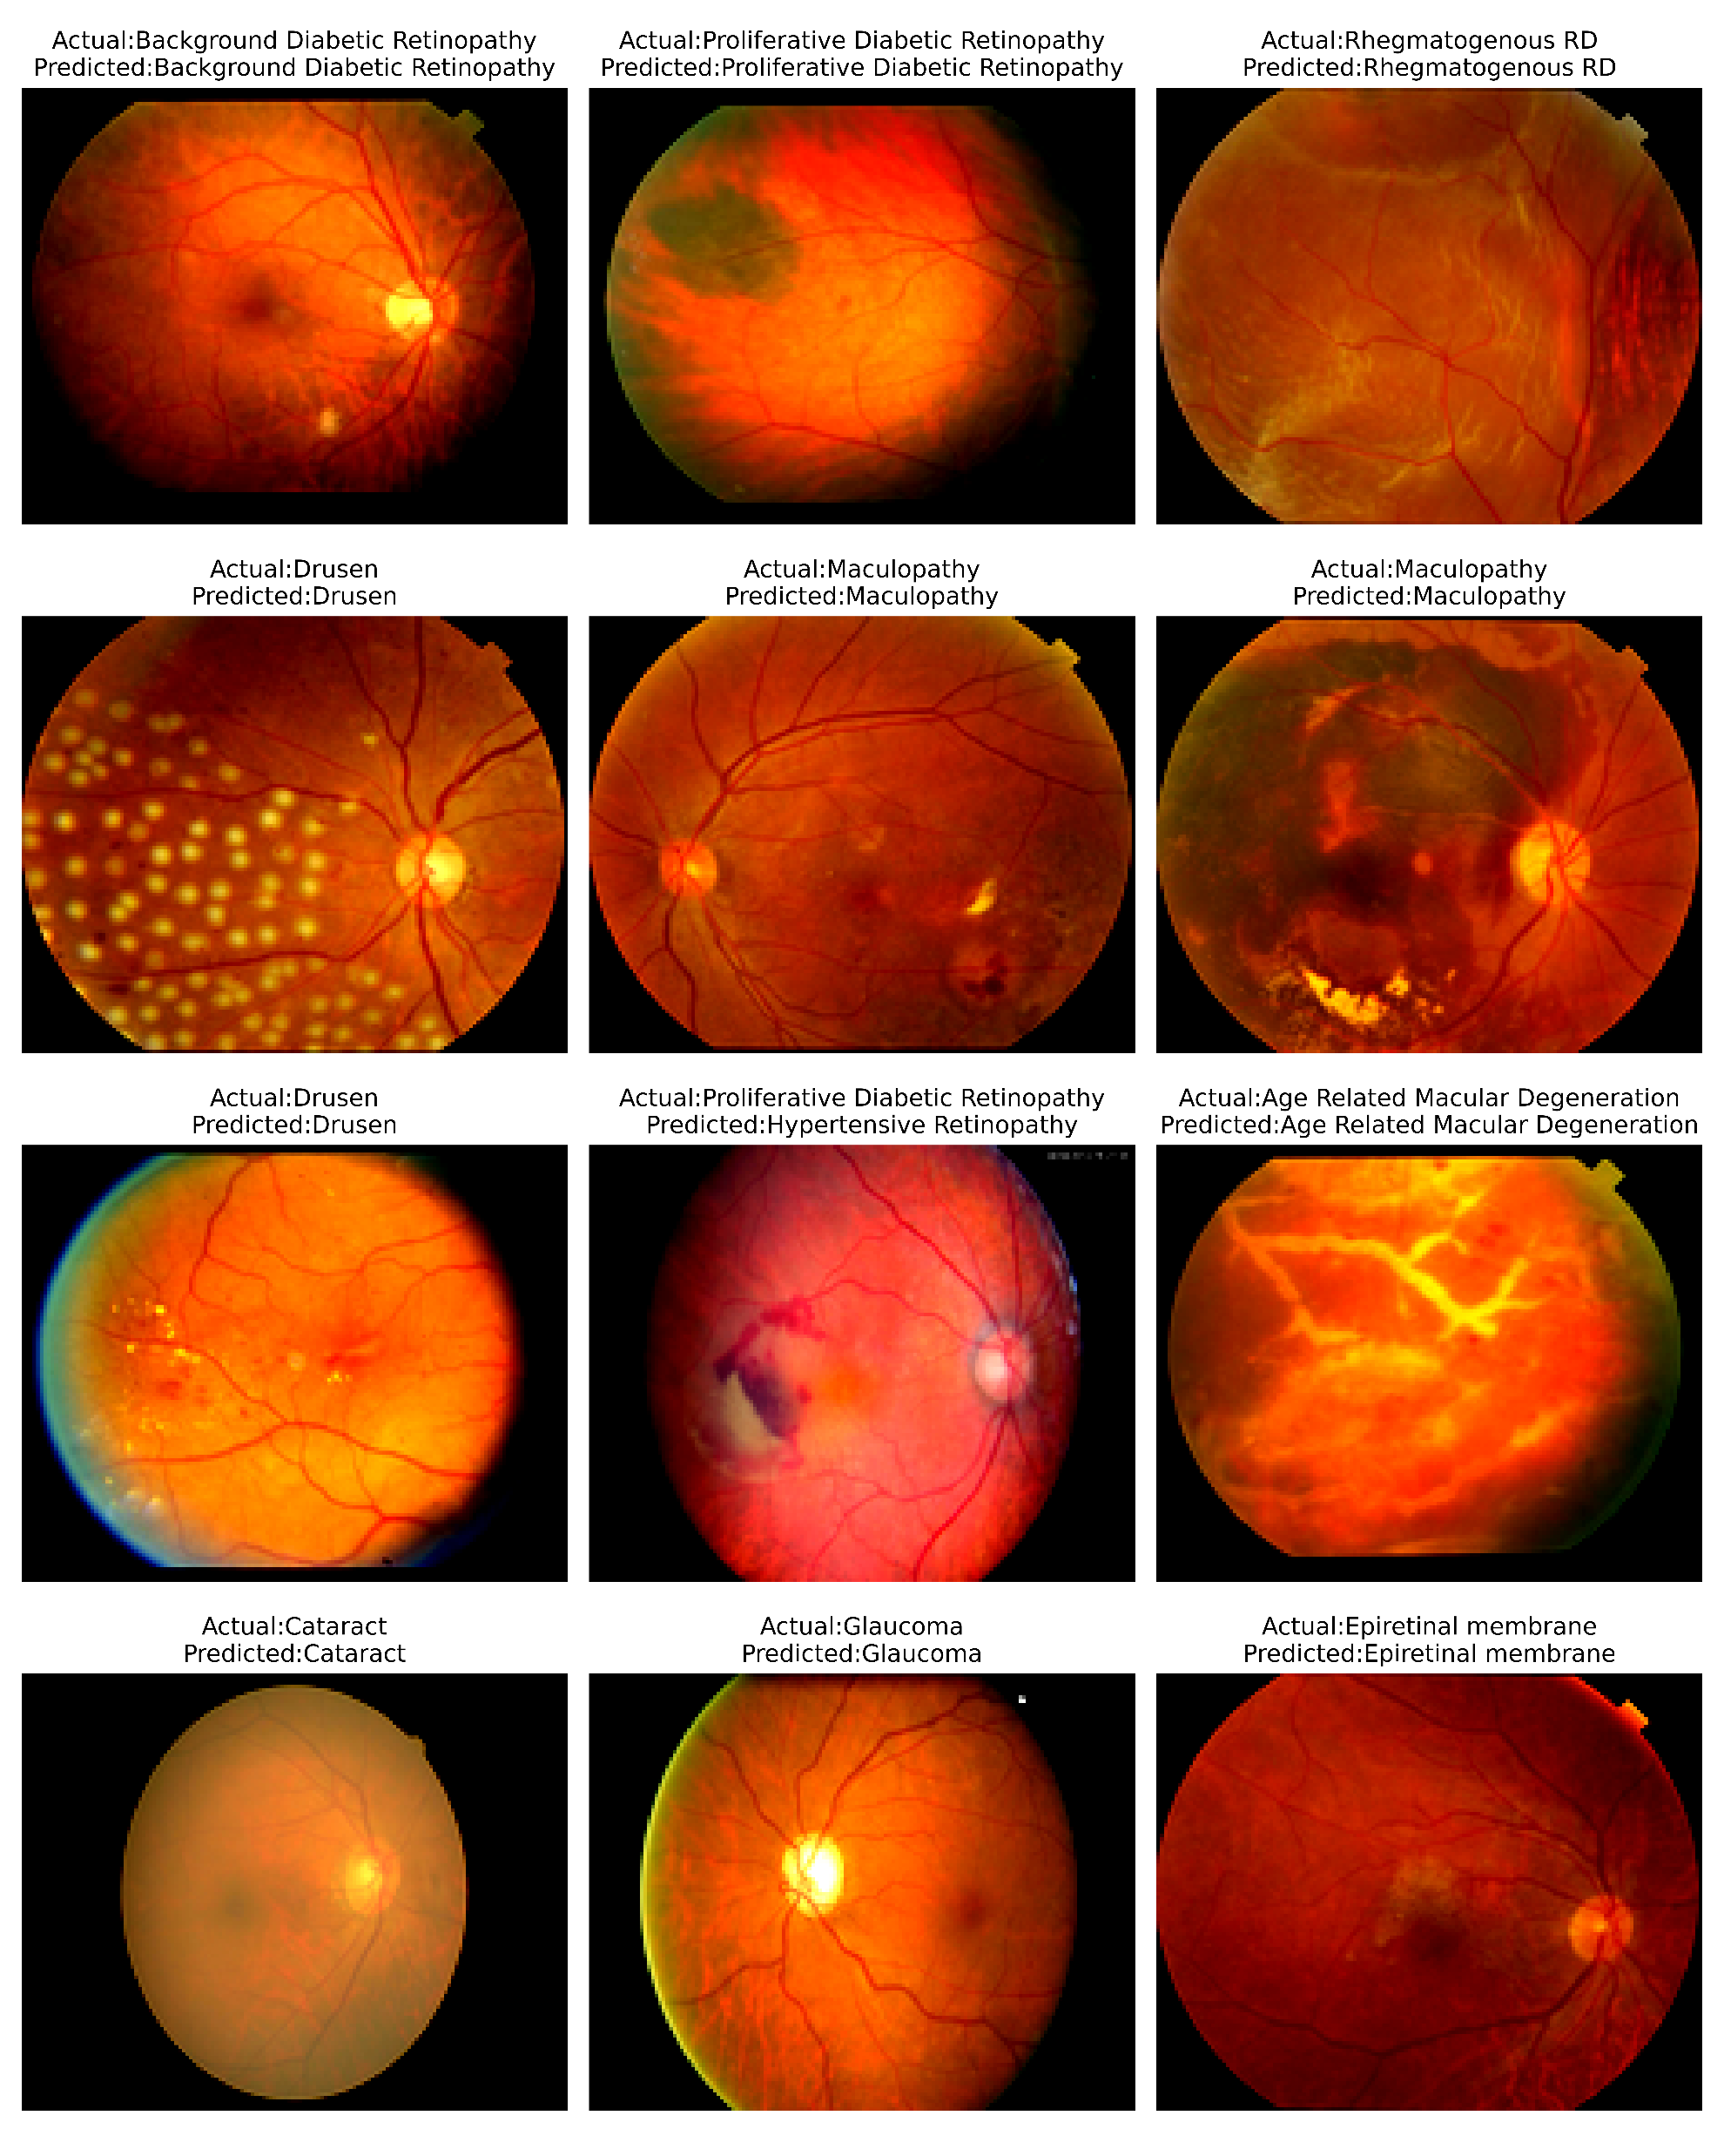
RESULT
Figure 1
9

Slide 10
Conclusion
In conclusion, the development of automated systems for eye cancer detection using deep learning techniques holds significant promise for improving early diagnosis, enhancing accuracy, and ultimately saving lives. Through the utilization of advanced image processing algorithms and convolutional neural networks (CNNs), these systems have demonstrated remarkable potential in accurately identifying various types and stages of eye cancer from medical images.
By leveraging large and diverse datasets, incorporating transfer learning, and optimizing model architectures, researchers and healthcare professionals have made substantial strides in developing robust and reliable eye cancer detection models. These models have shown promising performance metrics, including high accuracy, sensitivity, and specificity, in discriminating between healthy and cancerous eye images.
10

Slide 11
REFERENCES
Python: https://python.org/
Numpy: https://numpy.org/
PyTorch: https://pytorch.org/
Flask: https://flask.palletsprojects.com/en/3.0.x/
Inspiration: https://projectworlds.in/artificial-intelligence-project-handwritten-digits-recognition/
11

